Slide 1
Binomial Theorem
Shreyas M
B.Tech in ECE PES University Bangalore

Slide 2
Chapter Map
Section | Topic
1 | Introduction
2 | Recap of Combinations
3 | Binomial Theorem
4 | Proof of theorem by mathematical induction
5 | Pascal’s Triangle
6 | General term and middle term
7 | Binomial Coefficients and their properties
8 | Useful shortcuts – (Revision Assignment)

Slide 3
1 Introduction
We have learnt the identities for (x+y)² ,(x-y)² ,(x+y)³ ,(x-y)³, etc.
But these are not just identities obtained by simple multiplying. They are governed by a pattern. By a theorem. The theorem which generalizes the expansion of a binomial powered to a positive integer.
Since we are considering exponent of only a binomial (“a + b” form), this theorem is called ‘Binomial Theorem’

Slide 4
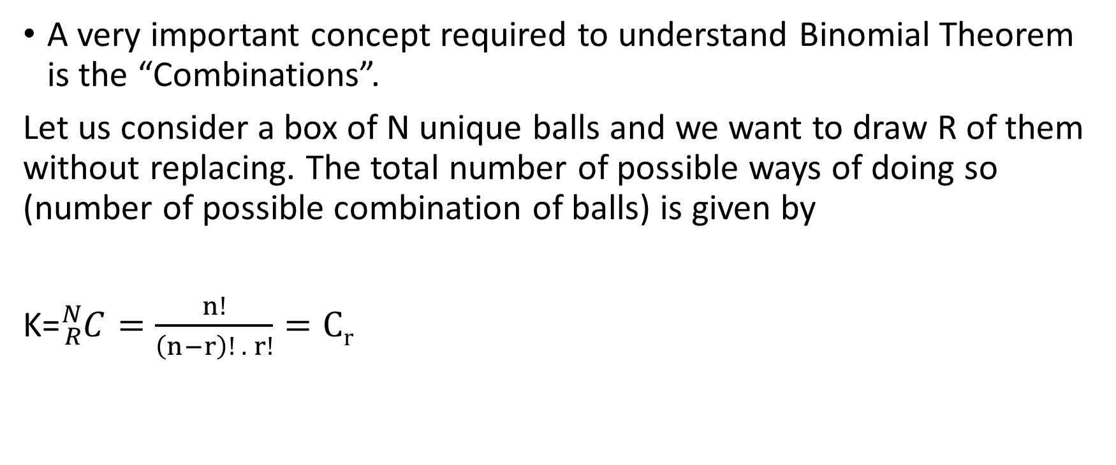
2 Recap of combinations
A very important concept required to understand Binomial Theorem is the “Combinations”.
Let us consider a box of N unique balls and we want to draw R of them without replacing. The total number of possible ways of doing so (number of possible combination of balls) is given by
K=${}_{R}^{N}C=\frac{n!}{\left(n−r\right)! . r!}=Cr$

Slide 5
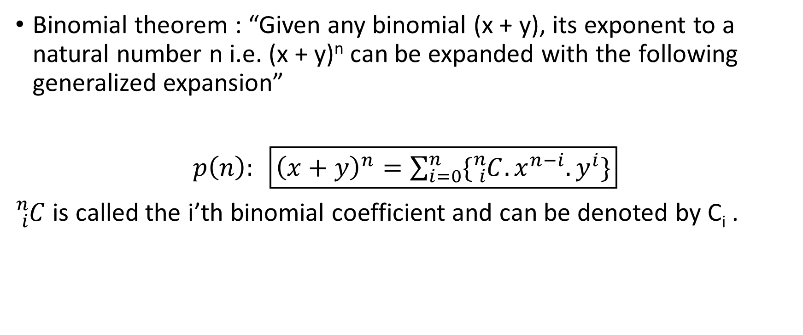
3 Binomial Theorem
Binomial theorem : “Given any binomial (x + y), its exponent to a natural number n i.e. (x + y)^{n} can be expanded with the following generalized expansion”
$p\left(n\right): \boxed{{\left(x+y\right)}^{n}=\sum_{i=0}^{n}{\{{}_{i}^{n}{C.x^{n−i}.y^{i}\}}}}$
${}_{i}^{n}C$ is called the i’th binomial coefficient and can be denoted by C_{i} .

Slide 6
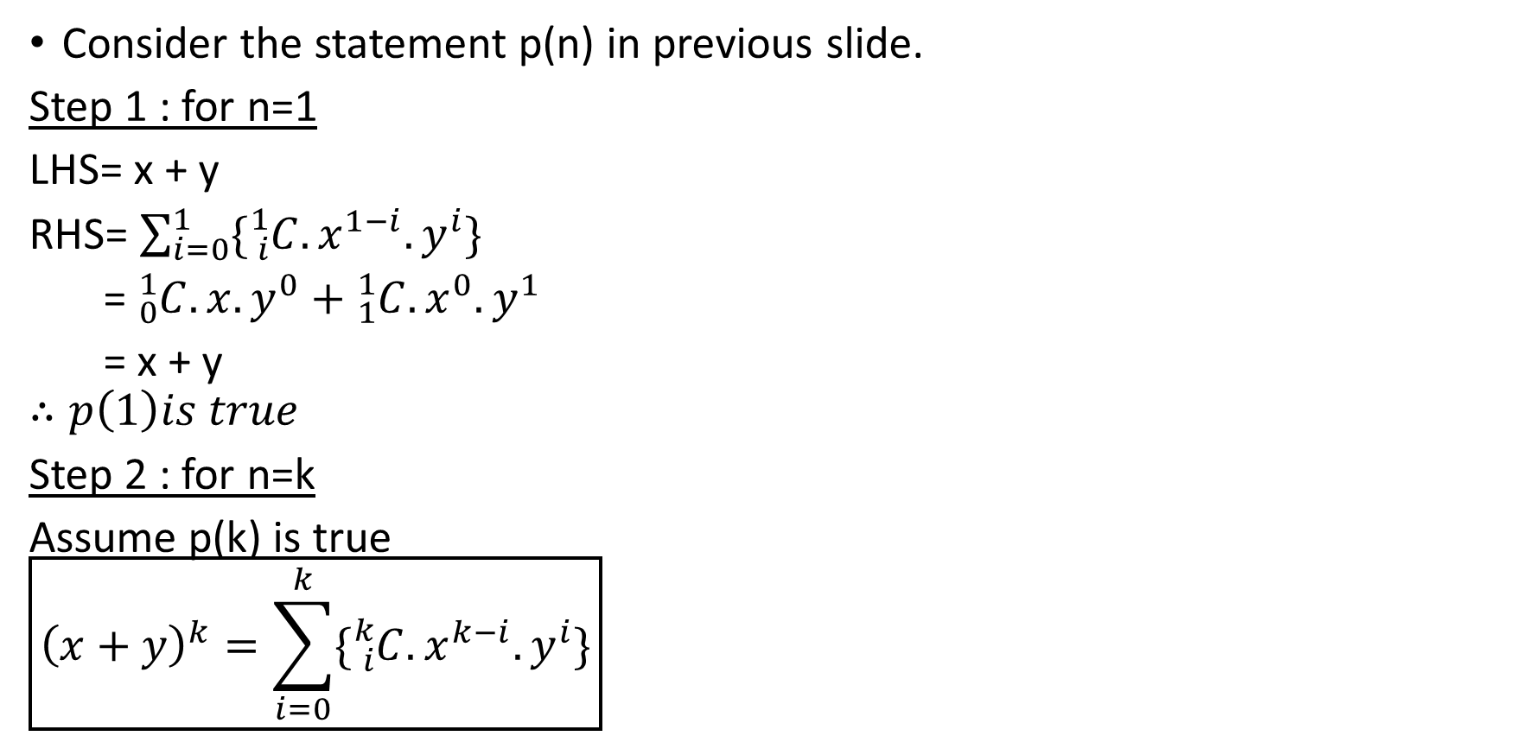
4 Proof of theorem by mathematical induction
Consider the statement p(n) in previous slide.
Step 1 : for n=1
LHS= x + y
RHS= $\sum_{i=0}^{1}{\{{}_{i}^{1}{C.x^{1−i}.y^{i}\}}}$
= ${}_{0}^{1}C.x.y^{0}+{}_{1}^{1}C.x^{0}.y^{1}$
= x + y
$$∴p\left(1\right)is true$$
Step 2 : for n=k
Assume p(k) is true
$$\boxed{{\left(x+y\right)}^{k}=\sum_{i=0}^{k}{\{{}_{i}^{k}{C.x^{k−i}.y^{i}\}}}}$$

Slide 7
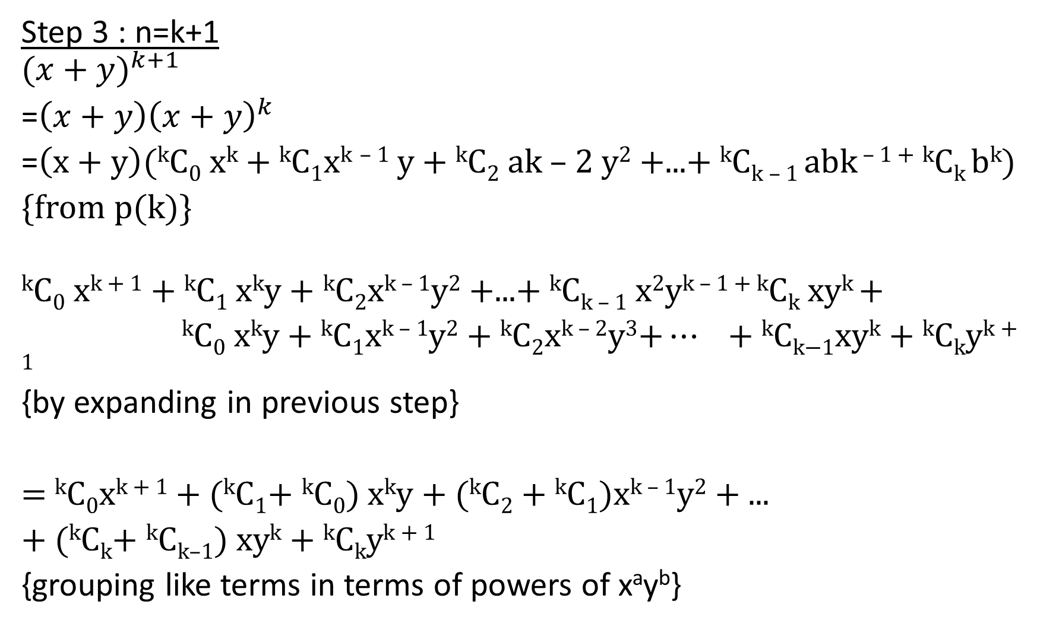
Step 3 : n=k+1
$${(x+y)}^{k+1}$$
=${\left(x+y\right)\left(x+y\right)}^{k}$
=$\left(x+y\right)\text{(}\text{k}\text{C}\text{0} \text{x}\text{k}\text{ + }\text{k}\text{C}\text{1}\text{x}\text{k} \text{– 1} \text{y}\text{ + }\text{k}\text{C}\text{2} \text{ak}\text{ – 2 }\text{y}\text{2}\text{ +...+ }\text{k}\text{C}\text{k}\text{ – 1 }\text{abk}\text{ – 1 +} \text{k}\text{C}\text{k} \text{b}\text{k}\text{)}$
{from p(k)}
$$\text{k}\text{C}\text{0} \text{x}\text{k}\text{ + 1}\text{ + }\text{k}\text{C}\text{1} \text{x}\text{k}\text{y}\text{ + }\text{k}\text{C}\text{2}\text{x}\text{k}\text{ – 1}\text{y}\text{2}\text{ +...+ }\text{k}\text{C}\text{k}\text{ – 1} \text{x}\text{2}\text{y}\text{k}\text{ – 1 + }\text{k}\text{C}\text{k} \text{xy}\text{k} \text{+ }$$
$\text{k}\text{C}\text{0} \text{x}\text{k}\text{y} \text{+ }\text{k}\text{C}\text{1}\text{x}\text{k}\text{ – 1}\text{y}\text{2}\text{ + }\text{k}\text{C}\text{2}\text{x}\text{k}\text{ – 2}\text{y}\text{3}\text{+}… \text{+ }\text{k}\text{C}\text{k}\text{−1}\text{xy}\text{k}\text{ + }\text{k}\text{C}\text{k}\text{y}\text{k}\text{ + 1}$ {by expanding in previous step}
= ^{k}C₀x^{k + 1} + (^{k}C₁+ ^{k}C₀) x^{k}y + (^{k}C₂ + ^{k}C₁)x^{k – 1}y² + ...
+ (^{k}C_{k}+ ^{k}C_{k–1}) xy^{k} + ^{k}C_{k}y^{k + 1}
{grouping like terms in terms of powers of xªy^{b}}

Slide 8
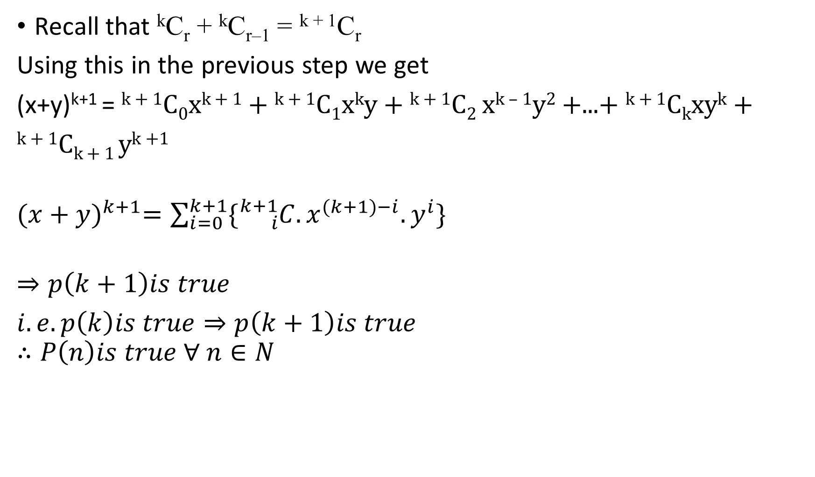
Recall that ^{k}C_{r} + ^{k}C_{r–1} = ^{k + 1}C_{r}
Using this in the previous step we get
(x+y)^{k+1} = ^{k + 1}C₀x^{k + 1} + ^{k + 1}C₁x^{k}y + ^{k + 1}C₂ x^{k – 1}y² +...+ ^{k + 1}C_{k}xy^{k} +
^{k + 1}C_{k + 1} y^{k +1}
${(x+y)}^{k+1}=\sum_{i=0}^{k+1}{\{{}_{i}^{k+1}{C.x^{(k+1)−i}.y^{i}\}}}$
$$⇒p\left(k+1\right)is true$$
$i.e. p\left(k\right)is true⇒p\left(k+1\right)is true$
$$∴P\left(n\right)is true ∀ n∈N$$

Slide 9
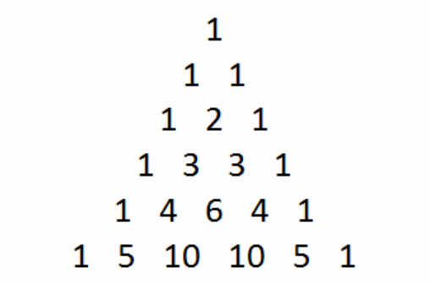
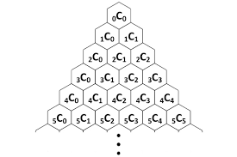

4 Pascal’s Triangle
Pascal’s triangle is the triangle formed by the Binomial coefficients.
It can be noticed that for the expansion of ${(x+y)}^{n}$, there are n+1 terms

Slide 10
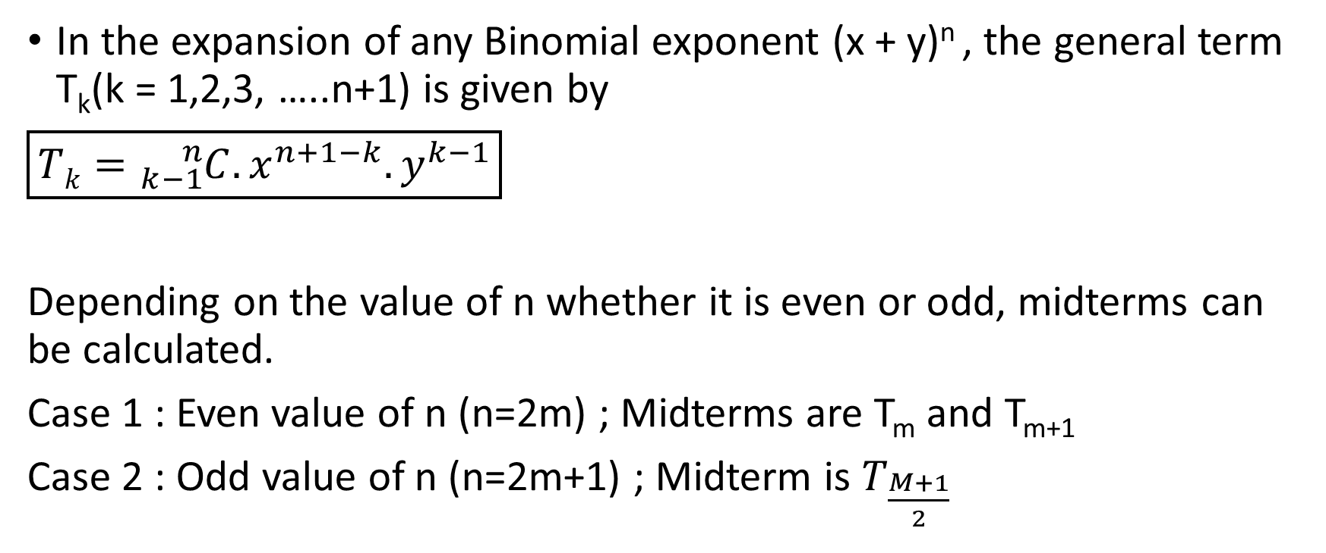
5 General term and middle term
In the expansion of any Binomial exponent (x + y)^{n} , the general term T_{k}(k = 1,2,3, …..n+1) is given by
$\boxed{Tk={}_{k−1}^{n}{C.x^{n+1−k}.y^{k−1}}}$
Depending on the value of n whether it is even or odd, midterms can be calculated.
Case 1 : Even value of n (n=2m) ; Midterms are T_{m} and T_{m+1}
Case 2 : Odd value of n (n=2m+1) ; Midterm is $T_{\frac{M+1}{2}}$

Slide 11
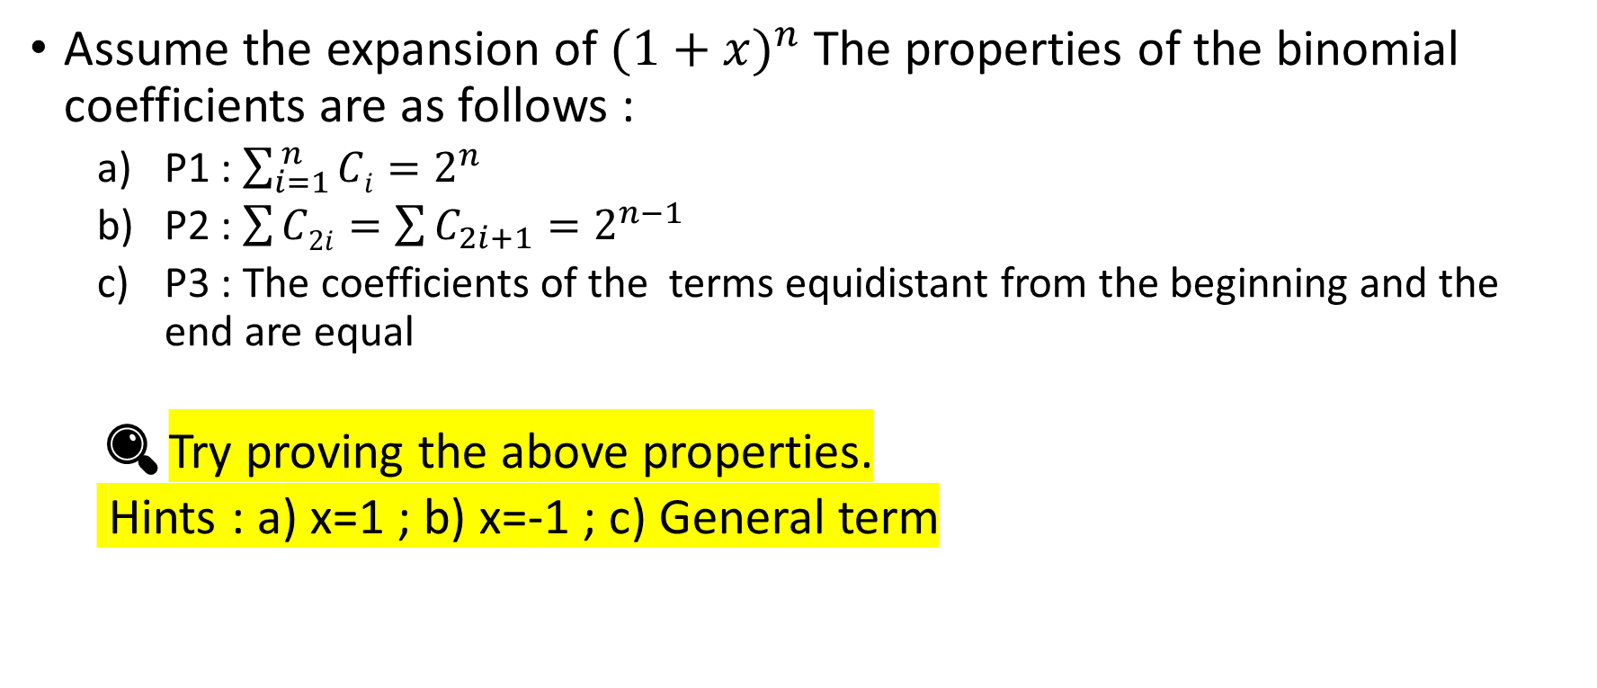
6 Binomial Coefficients and their properties
Assume the expansion of ${(1+x)}^{n}$ The properties of the binomial coefficients are as follows :
P1 : $\sum_{i=1}^{ n}{Ci}=2^{n}$
P2 : $\sum{C2i}=\sum{C_{2i+1}}=2^{n−1}$
P3 : The coefficients of the terms equidistant from the beginning and the end are equal
🔍Try proving the above properties.
Hints : a) x=1 ; b) x=-1 ; c) General term

Slide 12
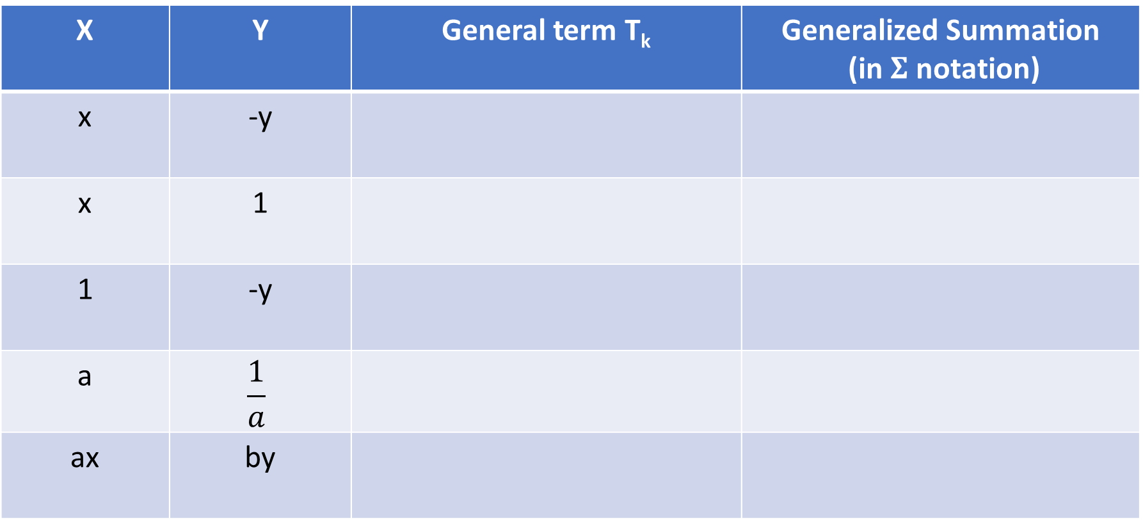
8 Useful Shortcuts (Revision Assignment)
Fill up the following table (Simplify completely wherever required)
X | Y | General term T_{k} | Generalized Summation (in $Σ$ notation)
x | -y
x | 1
1 | -y
a | $$\frac{1}{a}$$
ax | by

Slide 13
Thank you
Shreyas M
B.Tech in ECE PES University Bangalore

